Slide 1
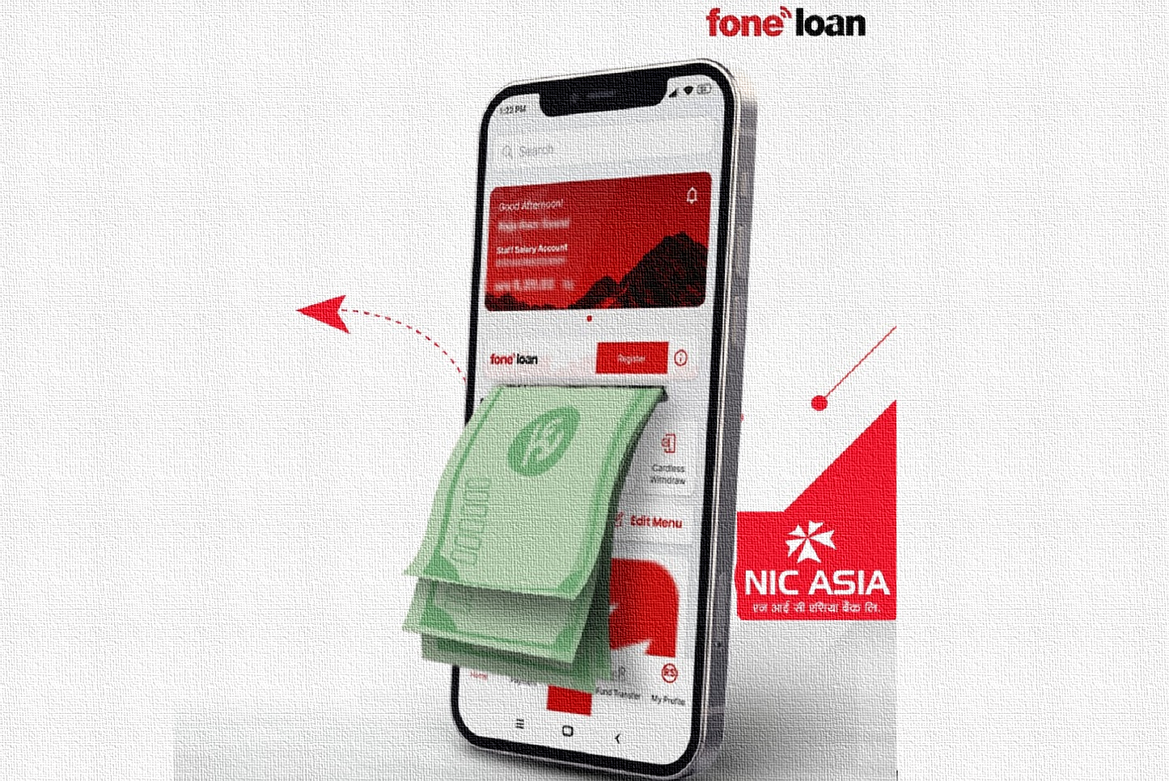
C PROGRAMMING
PROJECT
(MOBILE BANKING SYSTEM)
→MEMBERS←
-SANKALPA GAUTAM(78)
-SHIV KUMAR YADAV(79)
-SUJAN ADHIKARI(86)
-SUSHIL YADAV(92)

Slide 2
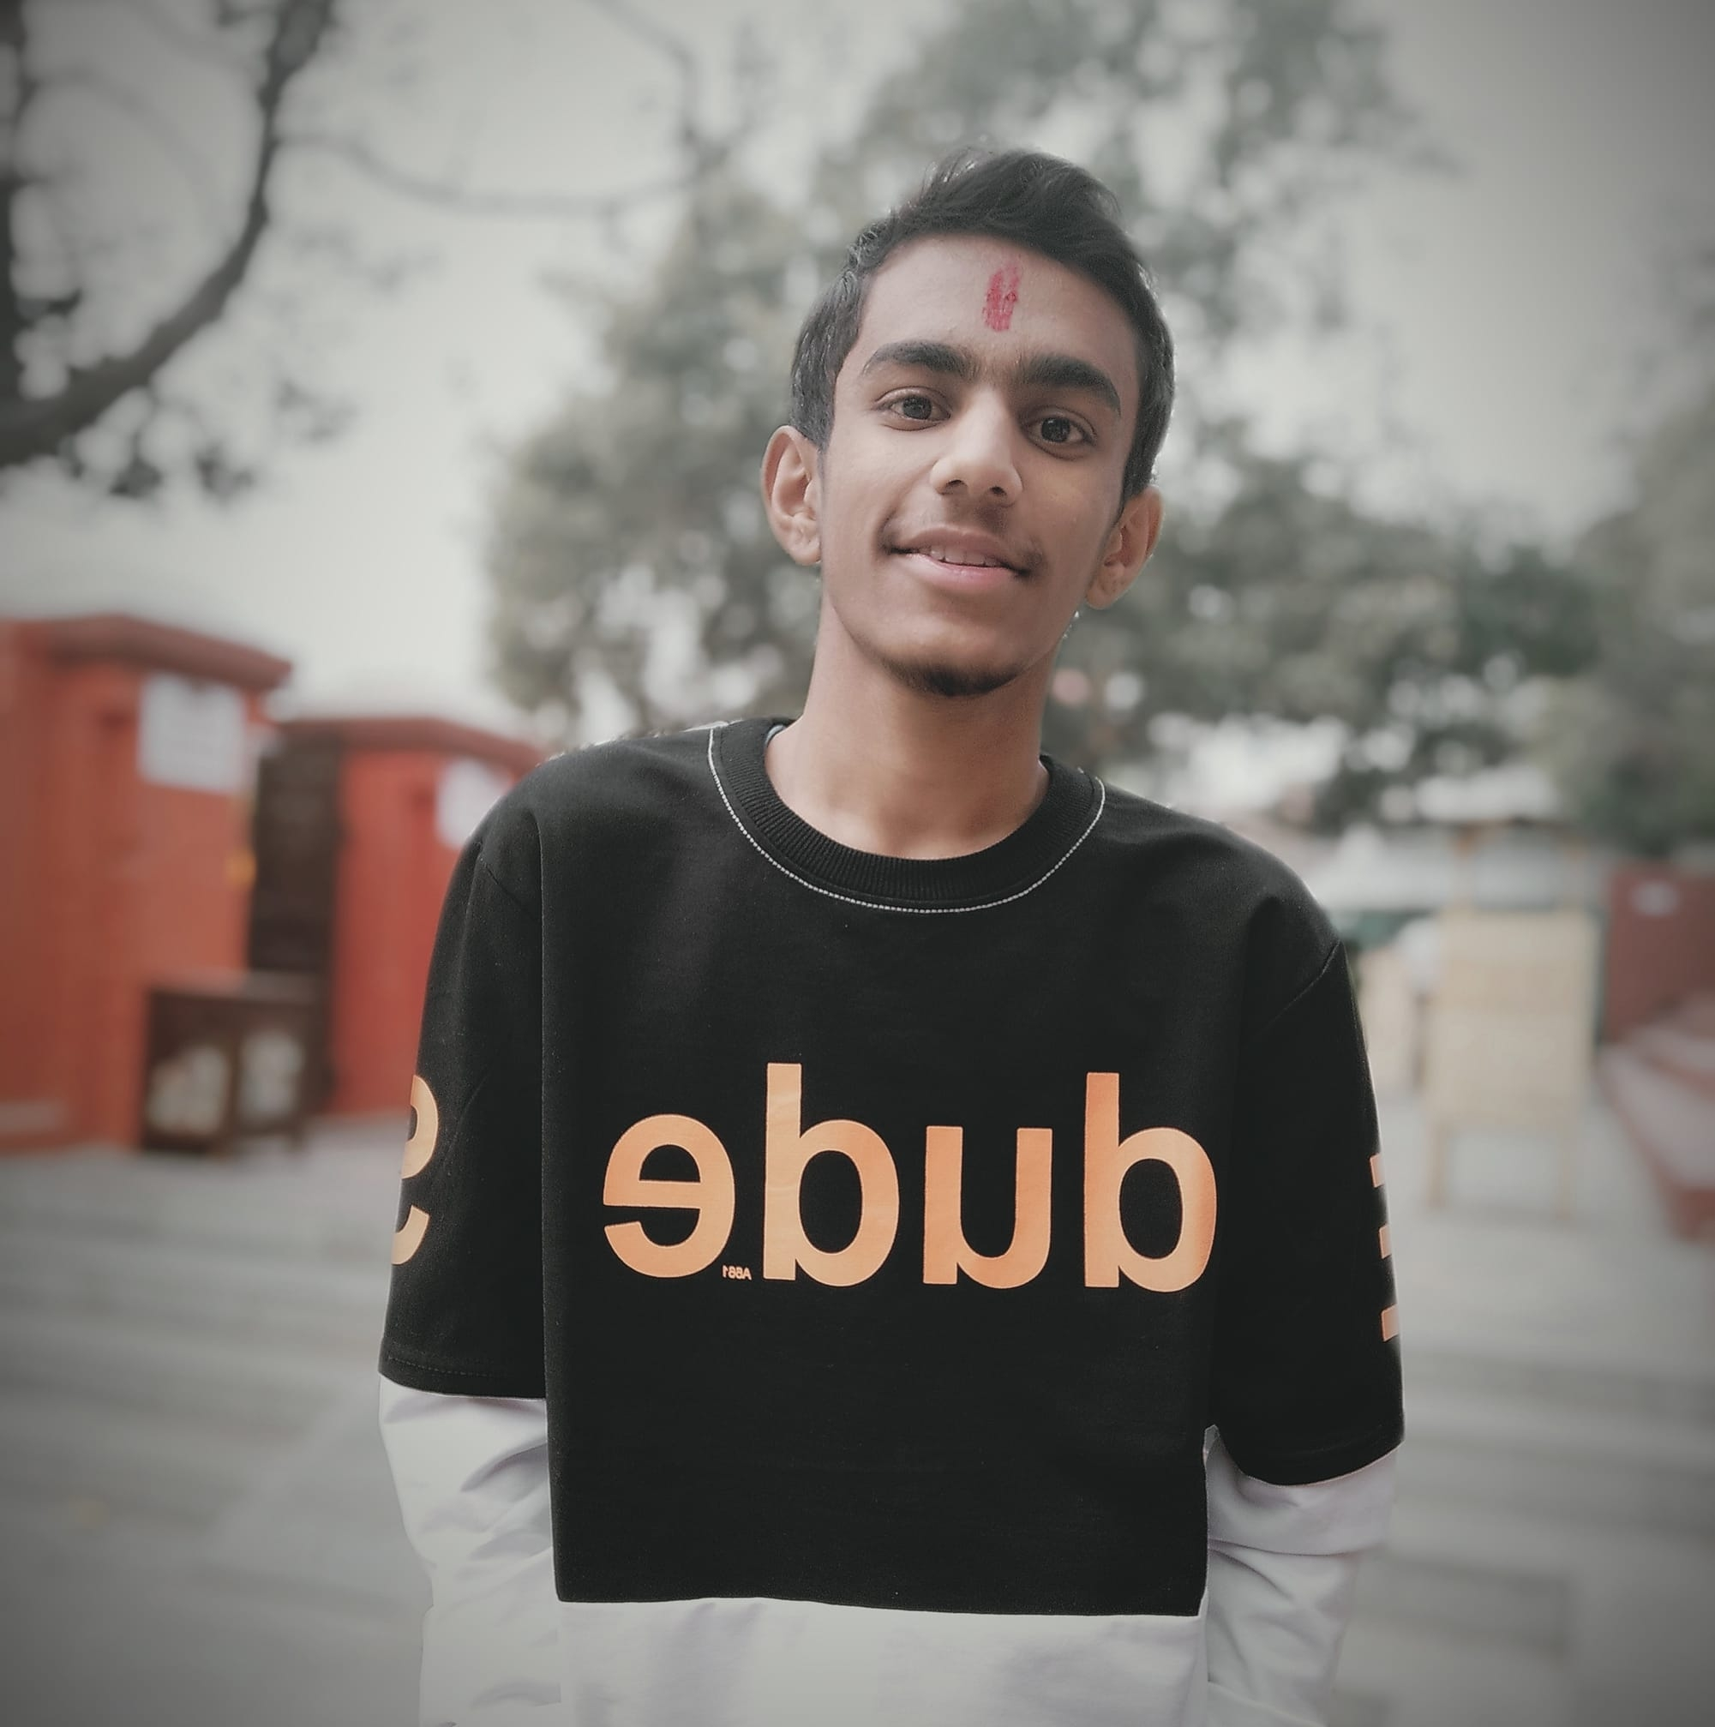
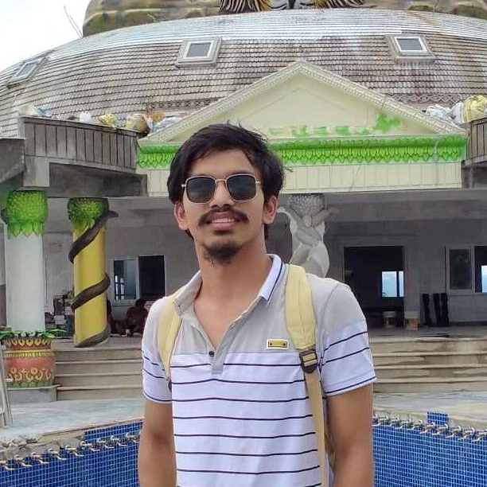
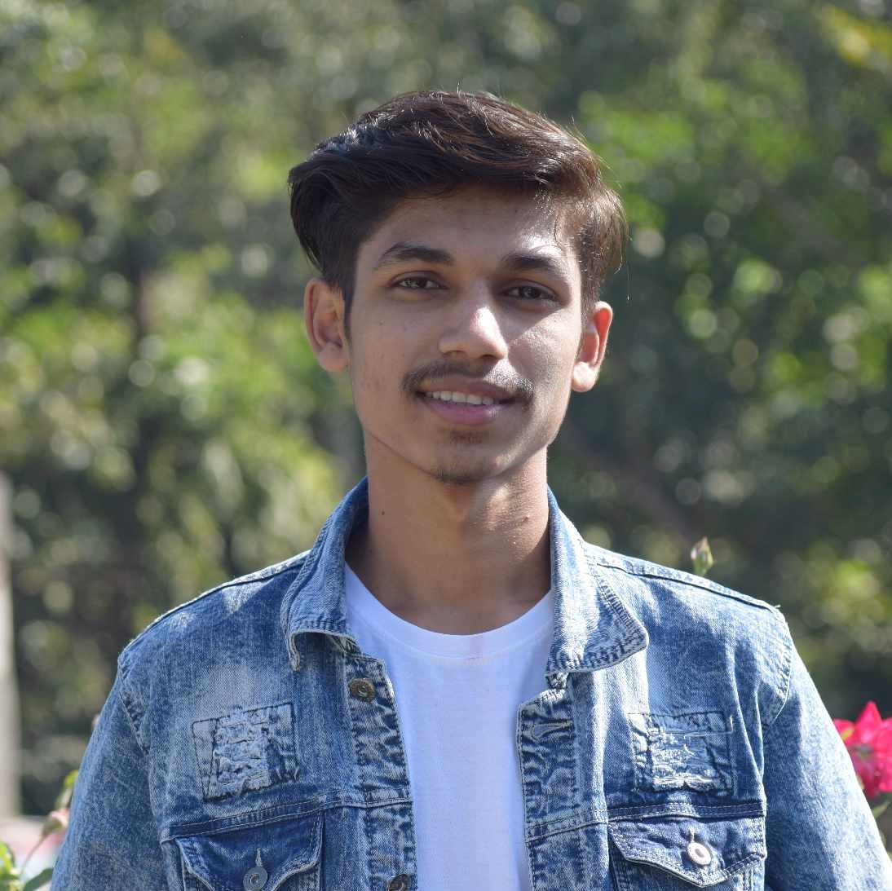
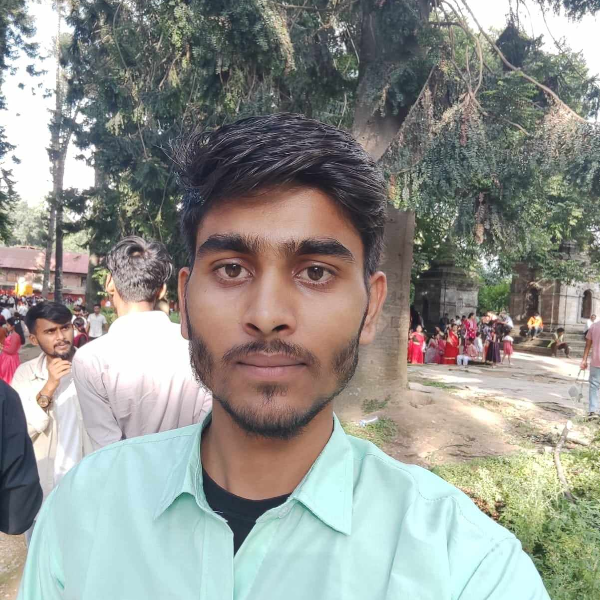
Our Team Style
079BCT079
079BCT092
SHIV KUMAR YADAV
SUSHIL YADAV
shivyadav
sushilyadav
079BCT078
079BCT086
SANKALPA GAUTAM
SUJAN ADHIKARI
sujanadhikari
sankalpagtm

Slide 3


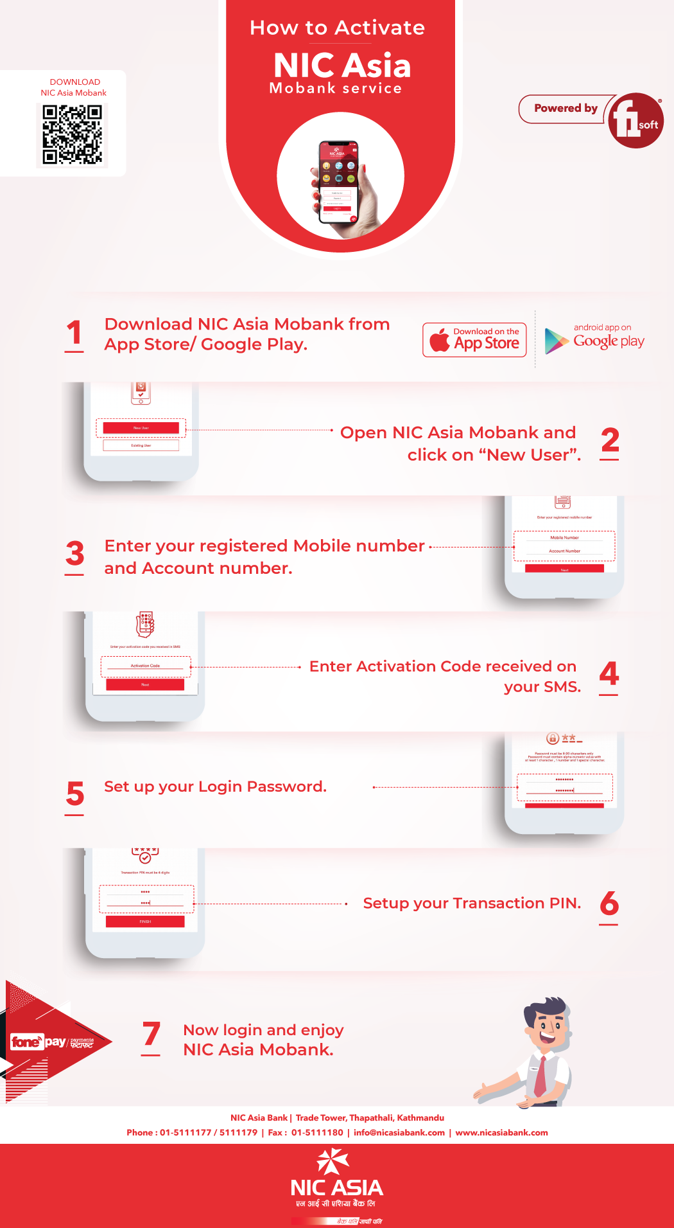
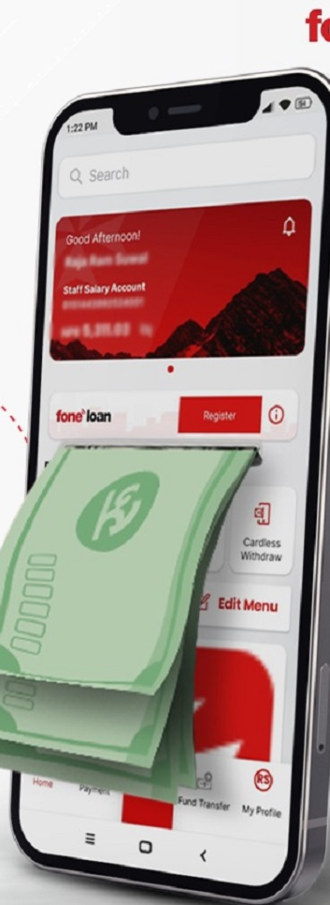
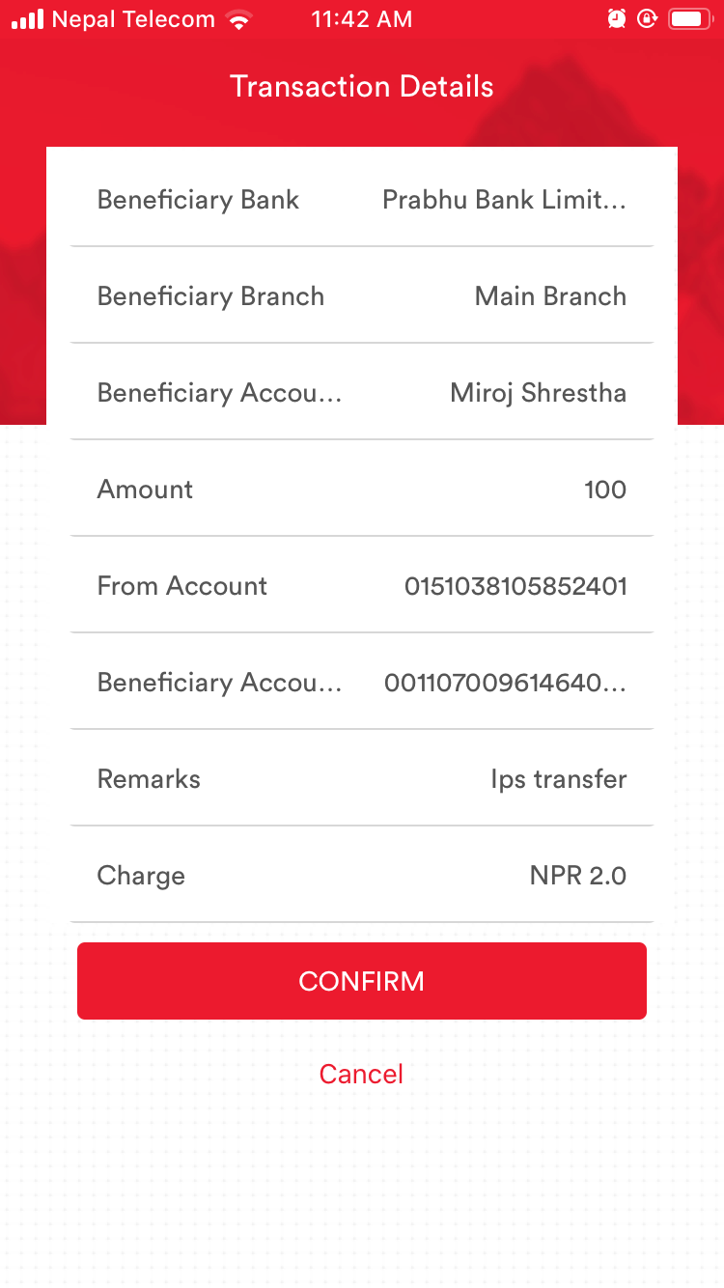
INTRODUCTION
Welcome to our C programming project, where we present the Mobile Banking System! Imagine managing your money effortlessly and securely, right from your mobile phone. With this innovative system, you can carry out banking tasks anytime, anywhere.
Our team of skilled developers has worked hard to create a user-friendly experience. From checking your account balance to transferring funds and viewing transaction history, it's all made simple and convenient.
We prioritize reliability and efficiency, making sure your financial interactions are smooth and hassle-free. This project is designed to adapt to future updates and technological advancements.
So, join us on this exciting journey where modern banking meets the power of C programming. Get ready to experience a brighter and more accessible financial future!

Slide 4
OUR OBJECTIVE
EFFICIENCY
5%
95%
LOAD
Our main goal is to build a user-friendly mobile banking system using C programming. This system will let users perform various banking tasks on their mobile devices while ensuring security. By using C programming, we're creating a strong and efficient app for real-time access to accounts, easy money transfers, bill payments, and transaction tracking. The simplicity of C programming helps us achieve fast performance and effective resource use. Our focus is on delivering a straightforward yet secure mobile banking solution that enhances the user experience.
SECURITY
100%

Slide 5



SERVICES YOU GET HERE
Registration and Login
Logout option
You can simply register your account by entering your account number, phone number and password and then login into your system.
You can simply log out your account using logout option and login to another account easily.
Balance inquiry and deposit
Pay Bills
You can check your balance and deposit your cash for online transaction
You can pay bills such as water and electricity bills easily through it.
Online transfer
Book Movie Tickets
You can transfer your money to another account simply and easily.
0.00
0.00
You can simply book movie tickets and online shows from the system.
International Flight Tickets
Subscriptions
Get a modern PowerPoint Presentation that is beautifully designed.
You can take subscriptions such as Netflix, Disney, Hotstar etc.

Slide 6
conclusion
In the end, creating our mobile banking system with C programming has been a journey of bringing together technology and user needs. We got the idea because we saw how more people were using their phones for banking. By using C programming, which is good for making fast and efficient programs, we made a system that lets users do things like checking their accounts, sending money, paying bills, and seeing their transactions, all on their phones.
Picking C programming was important because it helps our system work smoothly and quickly. Looking back, we see that our project was about understanding what people want and using the right technology to make it happen. We wanted to make banking easier in this digital age, and our mobile banking system does just that. This project shows how we use technology to make life better and simpler for everyone who uses banking services.

Slide 7
THANK YOU
BE DIGITAL,GROW DIGITAL.

Slide 8
